Slide 1
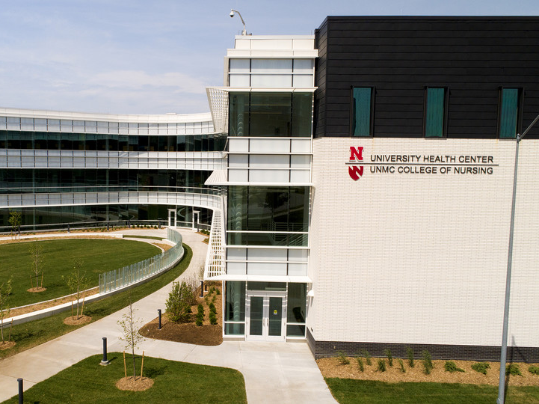
Student Insurance 101
An overview of UNL’s student health insurance plan for students

Slide 2
Presentation Objectives
Why health insurance is important
How to get the most out of your student insurance plan
What’s covered when you visit the University Health Center (medical, dental, pharmacy)
How much you pay if you go to off-campus healthcare facilities
How to confirm or waive your coverage

Slide 3
U.S. Health Care System
The U.S. does not offer free medical care to the general public
Medical care is very expensive
Insurance helps with the cost of unexpected injuries and illnesses

Slide 4
Insurance is Important
An unexpected injury or illness can put you in debt for decades
You can’t predict an accident or serious illness
Insurance provides peace of mind
Insurance can help you stay or get healthy
Your health and well-being are critical to your academic success
The University of Nebraska requires international students to have health insurance

Slide 5
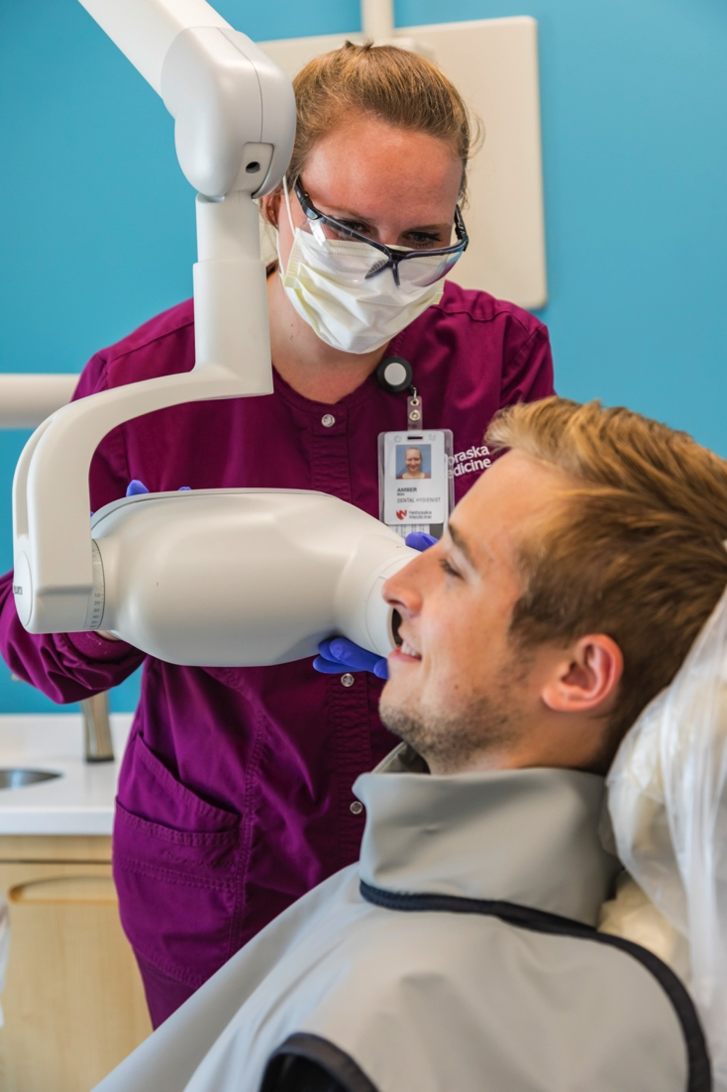
UnitedHealthcare StudentResources
UnitedHealthcare StudentResources is the insurance plan provider
Health, dental and prescription coverage for one low rate

Slide 6

Automatic Enrollment and Billing
International students and most graduate assistants are automatically enrolled
Student Accounts automatically bills the premium to students’ accounts
Other Nebraska students enrolled in six or more credit hours in a degree-seeking program or are certified full time through Graduate Studies can voluntarily enroll in the UHCSR plan on MyRed

Slide 7
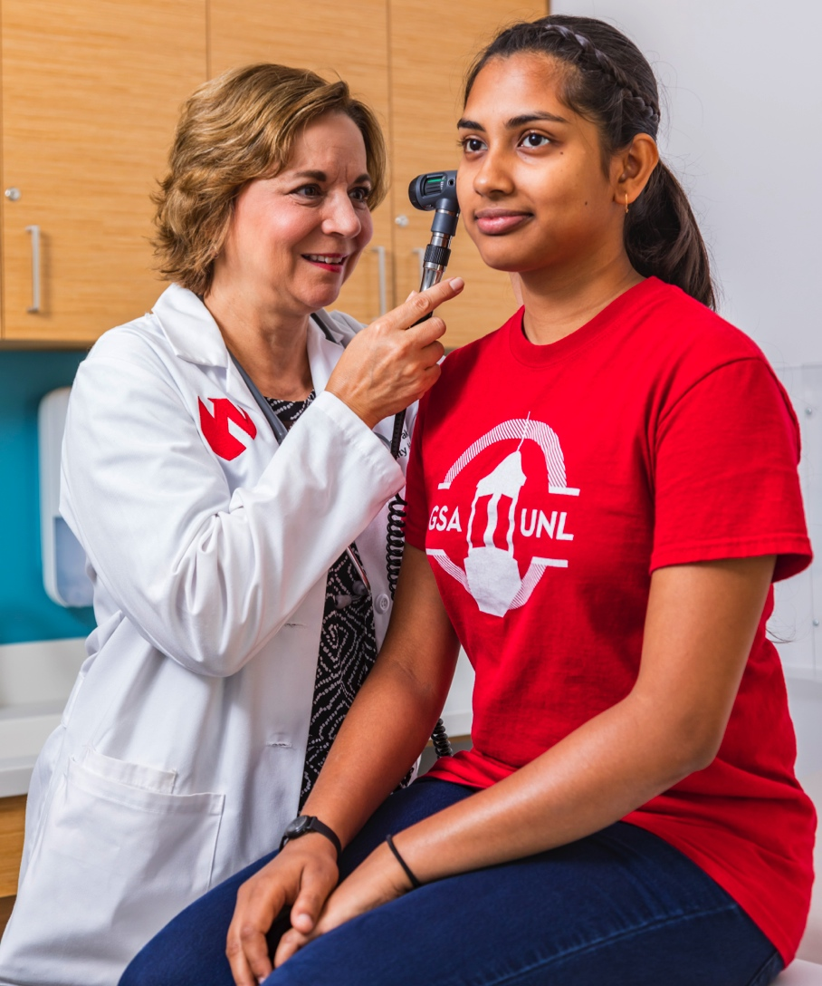
Coverage Periods
Fall semester
Aug. 1 to Dec. 31, 2019
Spring/Summer semester
Jan. 1 to July 31, 2020

Slide 8
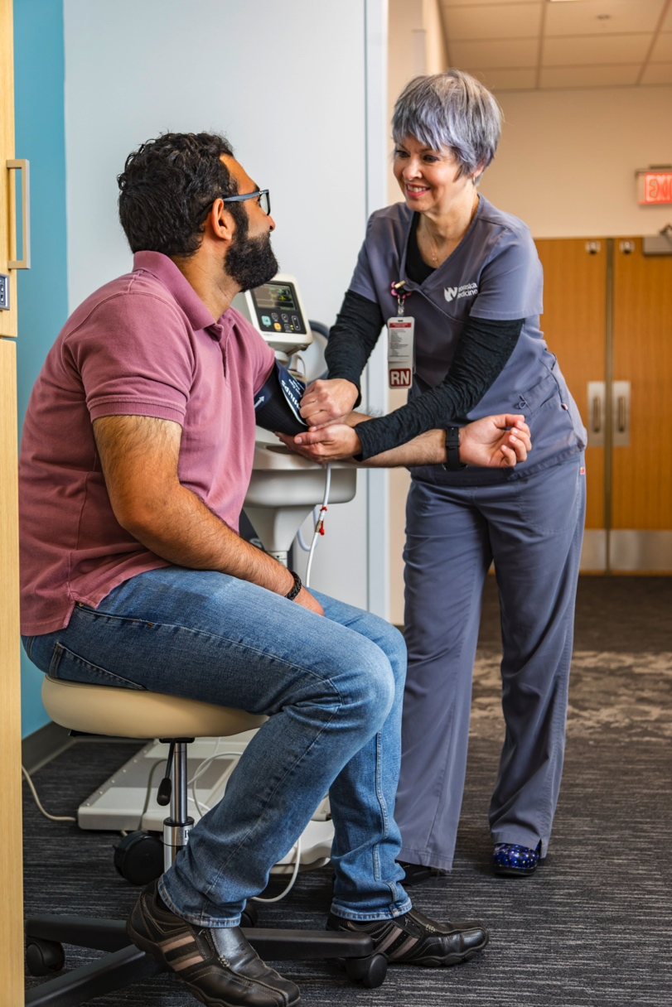
Dependent Coverage
Dependent coverage is available at a reasonable rate
Dependents must re-enroll for each coverage period

Slide 9
Premium Costs
Premiums | Fall Coverage Period | Spring/Summer Coverage Period
Student | $1,287.51 | $1,789.65
Spouse/Domestic Partner | $1,273.15 | $1,769.67
One Child | $1,280.75 | $1,780.25
Two or More Children | $2,483.75 | $3,452.25
Spouse and Two or More Children | $3,761.12 | $5,227.77
The school admin fee is $10 per covered person per enrollment period.

Slide 10
Graduate Assistant Rates
 | Fall Coverage Period | Spring/Summer Coverage Period
Graduate Assistant Portion: 21% | $270.38 | $375.83
University’s Portion: 79% | $1,017.13 | $1,413.82

Slide 11
Save Money — Use the University Health Center
Unlimited policy year maximum
No deductible, coinsurance or copays
Insurance pays 100 percent of medically necessary services, including:
  University health requirement immunizations and tests
  Medical procedures and annual exams
  Visits with medical specialists
  Annual optometry exam and refraction (glasses and contacts NOT covered)
  Laboratory tests
  X-rays
  Physical therapy
  Counseling and psychological services

Slide 12
Health Center UPFF
If you do not pay the University Program and Facilities Fee (UPFF) as part of your tuition package, you will be assessed this fee each semester you use the health center
This is a requirement to use the student insurance at the health center

Slide 13
Health Benefit Summary
In-network provider outside Nebraska Medicine – University Health Center
$20 copay for office visit outside of the University Health Center
$500 deductible per insured person per policy year
80% / 20% coinsurance
$2,200 maximum out-of-pocket expenses — includes deductible, coinsurance and copays

Slide 14
Emergency Room, Urgent Care and Health Center Copays
Emergency Room = $300
An emergency room visit must be a true emergency or it’s possible coverage could be denied
Urgent Care Center = $75
Student Health Center = No copay; covered at 100 percent

Slide 15
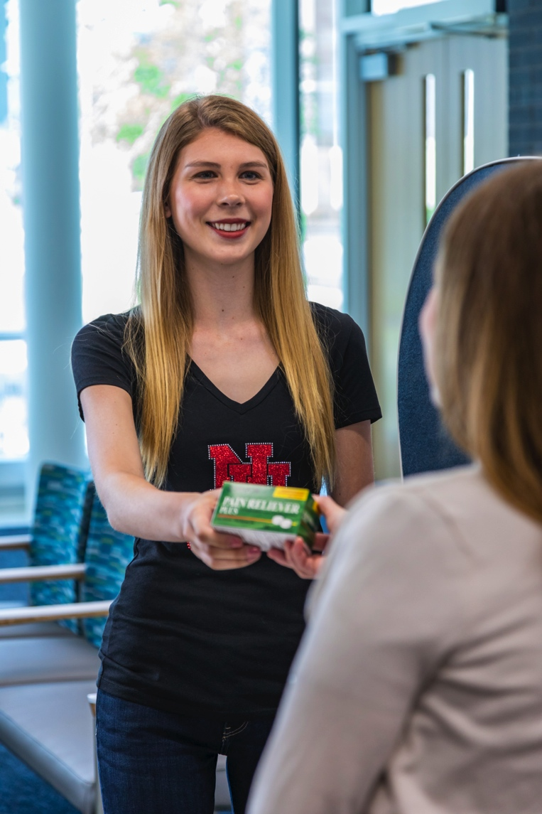
Prescription Benefit Summary
Benefits are maximized at Nebraska Medicine – University Health Center Pharmacy
• Unlimited policy year maximum
$5 copay for Tier 1 prescriptions
$30 copay for Tier 2 prescriptions
$80 copay for Tier 3 prescriptions

Slide 16
Dental Benefit Summary
$1,000 policy year maximum
Two healthy mouth cleanings, two exams and one set of bite wing X-rays per year are 100 percent covered
Those covered services come out of your $1,000 policy year maximum (You are responsible for keeping track of your maximum if you see dental providers outside the Health Center)
Other covered services – coinsurance applies

Slide 17
Automatic Enrollees
You must confirm or waive enrollment on your MyRed account by Sept. 12 at midnight
Missing this deadline may cause you a delay in accessing your insurance card

Slide 18
Confirm Your Enrollment
Although international students and graduate assistants are automatically enrolled and charged for UHCSR, please remember:
You should confirm enrollment in UHCSR via MyRed each semester
You MUST have your current local mailing address in MyRed
Please confirm enrollment for the fall semester before Sept. 12

Slide 19
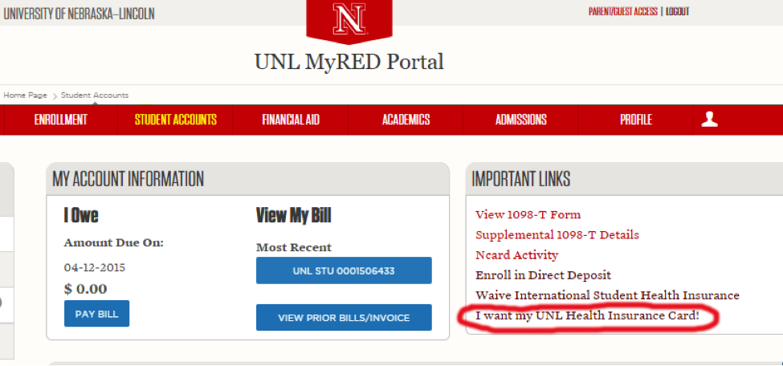
Confirm Your Enrollment
Does anyone here plan to accept the insurance and has not done so already?
Notes:
Give “How to Accept Insurance Coverage” handouts to those who raise their hand.

Slide 20
Get Your Insurance Card
In a few business days, you will receive an email from UnitedHealthcare StudentResources with instructions to get your card by signing up for “My Account”.

Slide 21
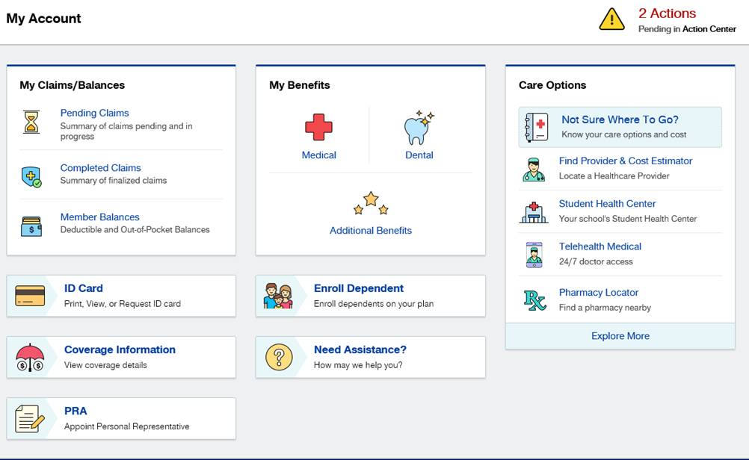
UHCSR My Account

Slide 22
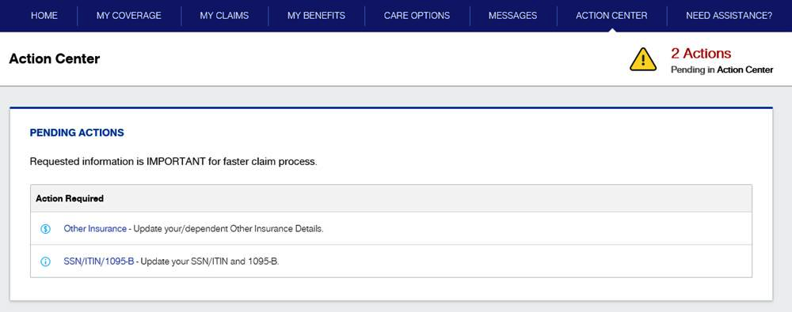
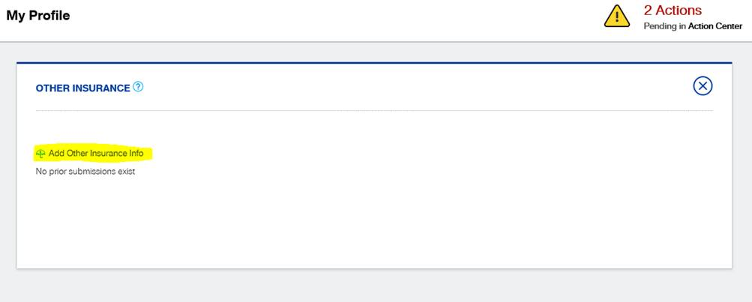

Slide 23
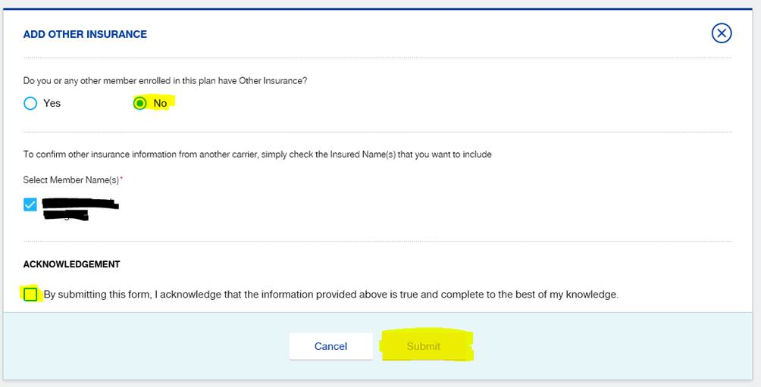

Slide 24
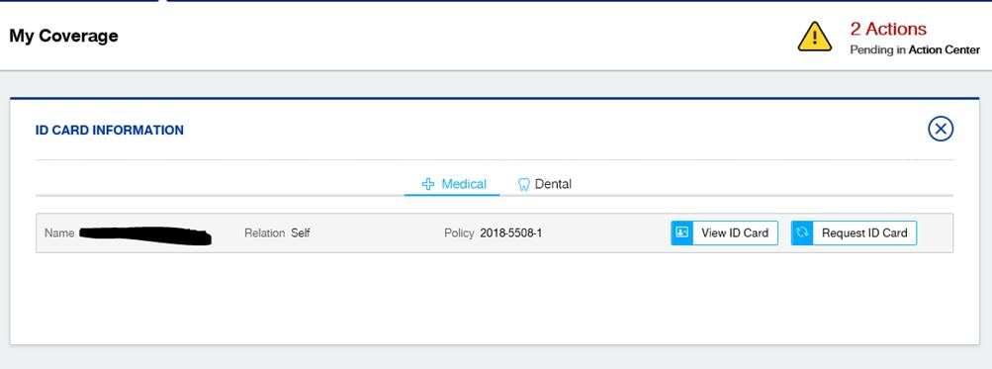
My Account Insurance Card

Slide 25
Waive Your Insurance
NEW THIS YEAR: International students may only waive the insurance if they meet one of these requirements set by the University of Nebraska:
Government-sponsored Plan with Financial Guarantee on file with Student Accounts
or
U.S. Employee based plan.
Non-international graduate assistants do not need to provide proof of equivalent health insurance benefits under another plan to waive the insurance

Slide 26
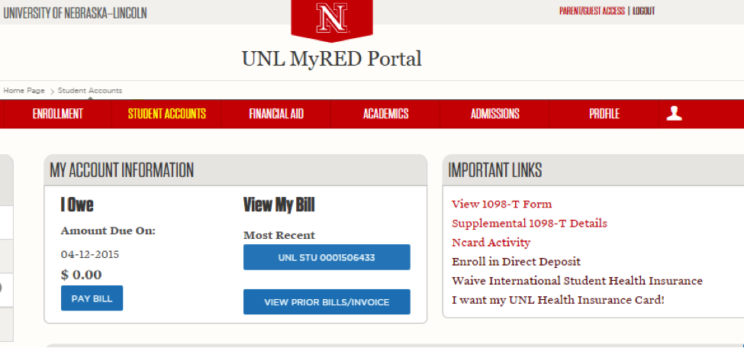
Waive Your Insurance

Slide 27
Be a Smart Health Care Consumer
Check plan details
Know your responsibility
Use preferred providers
Show your plan ID card
Read your EOBs
Call UHCSR with questions

Slide 28
Helpful Contacts
Student Insurance Coverage Questions:
Cindi Pickinpaugh
unebraskaadvocates@uhcsr.com
866-351-4262
Health Insurance Enrollment Questions:
Student Accounts at 402-472-2887
www.uhcsr.com/unl

Slide 29

Questions?

